Slide 1
Pendulum-based spectrogram generation
a MIR project (1st stage)
2022-05-31
Semjon Kravtšenko
Presentation version: 1.1

Slide 2
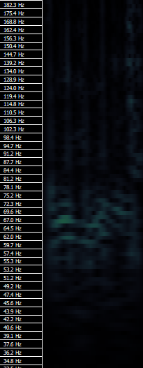
Shortcomings of previous methods
STFT has a laughably low resolution low frequencies
Constant-Q is better at recognizing bass frequency, but time resolution for it is insufficient
Super Constant-Q: still not good enough, starts to get very slow (on CPU)
Ah, yes, 16 clearly distinguishable bass
notes indeed are present here!

Slide 3
Why are they so bad?
People can tell 35hz and 37hz waves apart,
Even if they are being played for less than half a second!
There must be an issue with our approach...
How does the ear hear the bass?

Slide 4
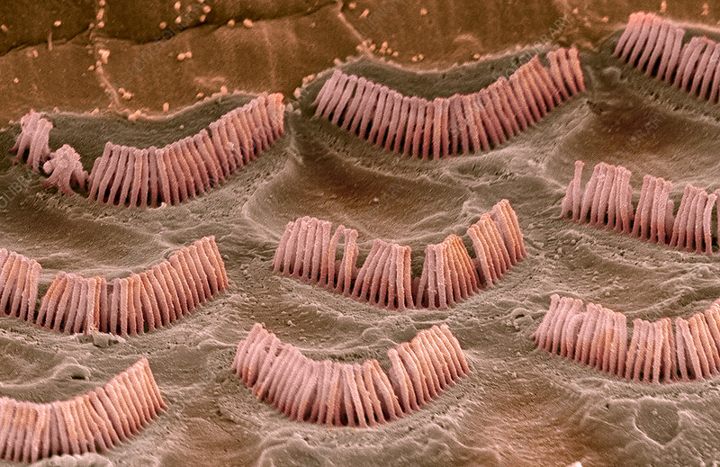
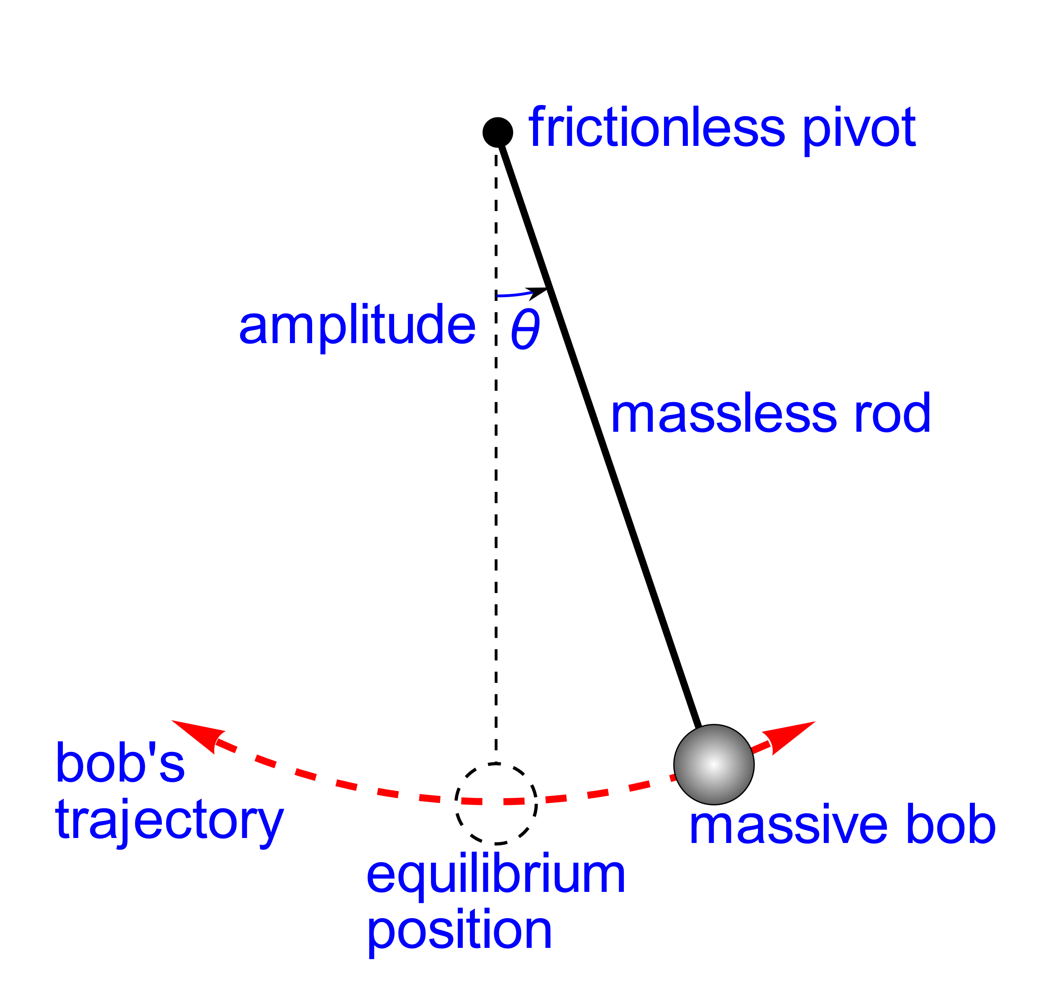
Lets make an educated guess: Pendulums!

Slide 5
Pendulums in their natural habitat
Response: pendulum reacts to the disturbances around it
Pull: pendulum accelerates towards its equilibrium point
Friction: oscillation amplitude diminishes with time
You get 10 points
for figuring out how this relates to
Discrete Fourier Transform

Slide 6
Post-processing or lack thereof
Aggregation:
speed fluctuates, but we take average of some period
Volume correction:
aggregated speed increases fast → ramp up perceived volume
aggregated speed decreases by the friction → immediate volume decay
Retrospective correction:
Knowning frequencies better after some time, correct earlier noise

Slide 7
Post-processing or lack thereof
Aggregation:
speed fluctuates, but we take average of some period
Volume correction:
aggregated speed increases fast → ramp up perceived volume
aggregated speed decreases by the friction → immediate volume decay
Retrospective correction:
Knowning frequencies better after some time, correct earlier noise
What else can we do?
Give this question a shot and share your ideas!

Slide 8
There is one tiny issue trough...
Half-tone resolution from 20 to 2560hz: ~84 pendulums
Five-cent resolution from 20 to 20000hz: ~2400 pendulums
Reasonable sample rates: 8000hz, 44100hz, 48000hz
Reasonable durations: 30 seconds, 3 minutes, 15 minutes
Calculating physics is not demanding, but it still takes cycles (~100?)

Slide 9
= at least 2 billion CPU cycles, up to 300 billions if you want to flex

Slide 10

= at least 2 billion CPU cycles, up to 300 billions if you want to flex

Slide 11
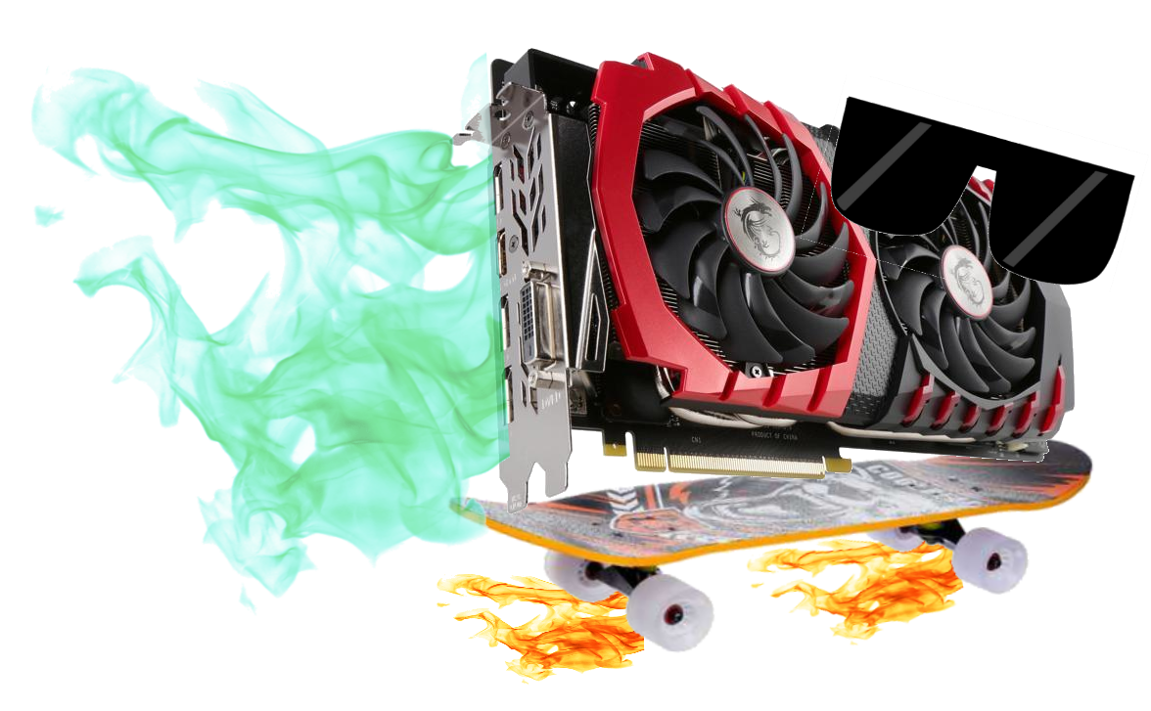
= at least 2 billion CPU cycles, up to 300 billions if you want to flex

Slide 12

#version 430 layout(local_size_x = 1, local_size_y = 1, local_size_z = 1) in; layout (std430, binding=0) buffer buf_0 { double FRAME_RATE; double FRICTION; double LOUDNESS; double PULL[]; }; layout (std430, binding=1) buffer buf_1 { double hairs_freq[]; }; layout (std430, binding=2) buffer buf_2 { double samples[]; }; layout (std430, binding=3) buffer buf_3 { double cyc_agg[]; // Cycling aggregate speed }; layout (std430, binding=4) buffer buf_4 { double activation[]; // N_hairs * hair_i + out_i }; // Returns an index of an hair private part of the array, wrapping if needed int wi(int i, int len) { int row = len / hairs_freq.length(); return int(gl_WorkGroupID.x) * row + ((i + len) % row); }
Speed comes at a price...
A L IGN M E NT
I S S U E S
COMPUTE
_{// Main shader code} _{void main() {} int hair_i = int(gl_WorkGroupID.x); // Bins that one halfsine constitutes double _halfsine_span = 0.5 * double(FRAME_RATE) / hairs_freq[hair_i]; highp int _halfsine_span_w = int(_halfsine_span); double _halfsine_span_d = _halfsine_span - double(_halfsine_span_w); _{double hair_pos = 0.0;} _{double hair_speed = 0.0;} _{double agitativeness = 0.0;} for (int op_i = 1; op_i < samples.length(); ++op_i) { hair_speed += - PULL[hair_i] * hair_pos; // acc_center_pull hair_speed += (samples[op_i] - samples[op_i - 1]); // acc_sound hair_speed += - FRICTION * hair_speed; // acc_friction _{hair_pos += hair_speed;} { _{int cl = cyc_agg.length();} _{int al = activation.length();} cyc_agg[wi(op_i, cl)] = cyc_agg[wi(op_i - 1, cl)] + abs(hair_speed); activation[wi(op_i, al)] = cyc_agg[wi(op_i, cl)]; activation[wi(op_i, al)] -= _halfsine_span_d * cyc_agg[wi(op_i - _halfsine_span_w - 1, cl)]; activation[wi(op_i, al)] -= (- _halfsine_span_d + 1.0) * cyc_agg[wi(op_i - _halfsine_span_w, cl)]; activation[wi(op_i, al)] /= hairs_freq[hair_i]; } } }
SHADERS
Crazy hardware quirks!

Slide 13
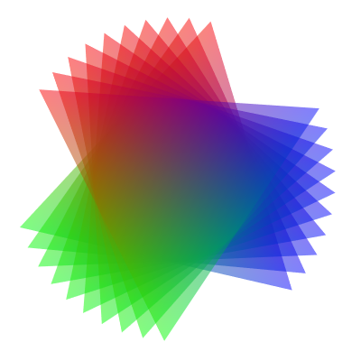

ModernGL: OpenGL made „easy“ (and for Python)
# Preparing the BRRR machine context = moderngl.create_context(standalone=True, require=430) # Nothing in OpenGL works without a context shader_str = open('./hair_shader.glsl', 'r').read() compute_shader = context.compute_shader(shader_str) # Create Compute Shader # Feeding it the buffers buffers = [] def new_buffer(_array, bf): _array = numpy.array(_array) _buffer = context.buffer(_array) _buffer.bind_to_storage_buffer(len(bf)) bf += [_buffer] new_buffer([fr, FRICTION, LOUDNESS] + PULL, buffers) new_buffer(hairs_freq, buffers) new_buffer(samples, buffers) cycling_speed_aggregate = numpy.zeros(HAIRS * (5 + math.ceil(fr / hairs_freq[0])), dtype=numpy.float64) new_buffer(cycling_speed_aggregate, buffers) raw_output = numpy.zeros(HAIRS * SAMPLES, dtype=numpy.float64) new_buffer(raw_output, buffers) # Running the BRRR machine compute_shader.run(group_x=HAIRS) # Read the buffer, interpret as floats, return arr = numpy.frombuffer(buffers[len(buffers) - 1].read(), dtype='<f8') arr.shape = (HAIRS, arr.size // HAIRS) arr = numpy.delete(arr, 0, 1)

Slide 14


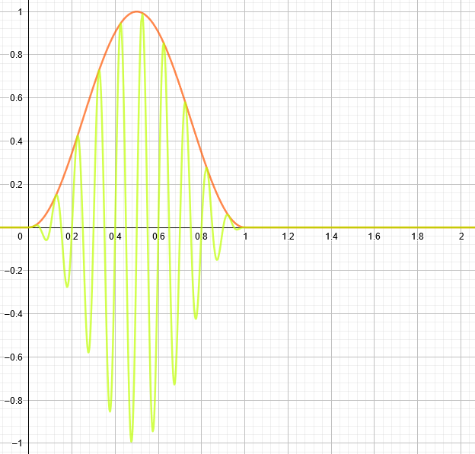
First results! Just abs(speed) of pendulums, no post-processing
↑ more bassy
↓ less bassy
50hz sine (smoothed amplitude) for 200 ms,
then 200ms of silence
It works! No aggregation, correction, nothing. Still usable!
Time of processing: negligeble.
Days of work almost paid off!
There was a very nasty bug somewhere...
What’s with those ugly vertical lines?!

Slide 15


An improvement. Tiny little bit of post-processing
Changes:
1. Amplitude-dependent friction. This has Constant-Q vibes ,
but we can fine-tune the parameters
2. Amplitude-dependent aggregation, over half-sine
You see that ugly tail?

Slide 16
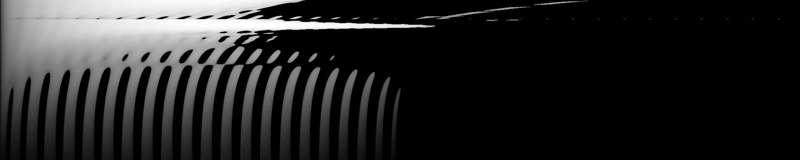
Bugs boundary... Becoming uncanny
Changes:
1. Try to compensate for amplitude diminishing
The first stage of the project ends here ☹
Still, this awful noise needs to go away..
What if we first measure (empirically)
noise level for each bin from each other bin,
and then (when creating spectrograms) correct accordingly?

Slide 17
For now, this is more or less a failure, but not completely unpromising
Further research needed^{(tm)}

Slide 18
Thank you!
Please ask questions

